Slide 2
eMRO System Overview

Slide 3
eMRO Information Flow Overview

Slide 4
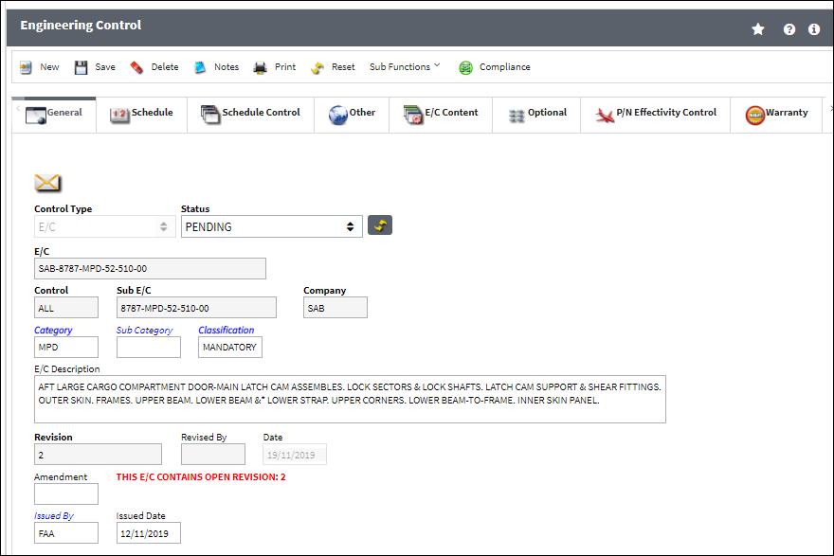
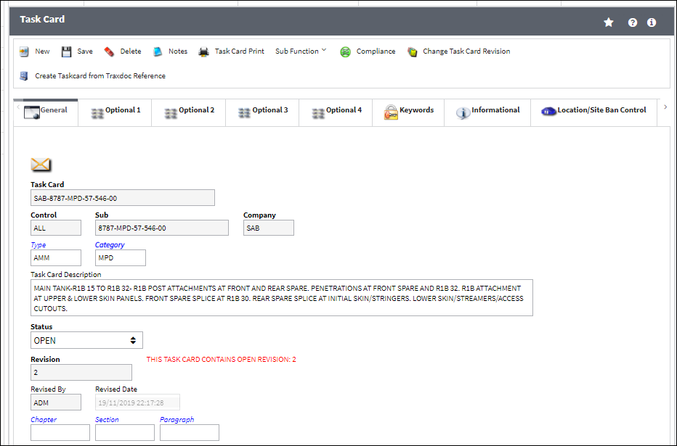
Scheduled Maintenance
The MX program for all fleets is entered as Engineering Controls and Task Cards
Task Cards hold the job requirements as well as material, skills and manhours required
Engineering Controls manage the schedule and effectivity of one or several Task Cards

Slide 5
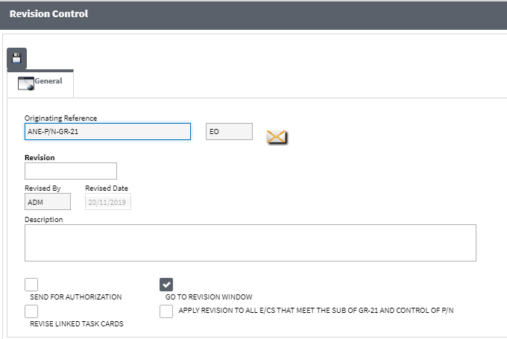
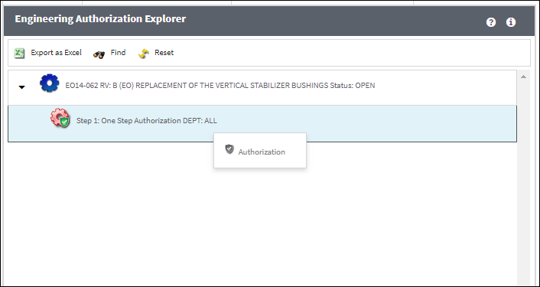
Scheduled Maintenance
A full revision control and authorization control is available for both Task Cards and Engineering Controls
Access to each screen can be managed via security settings

Slide 6
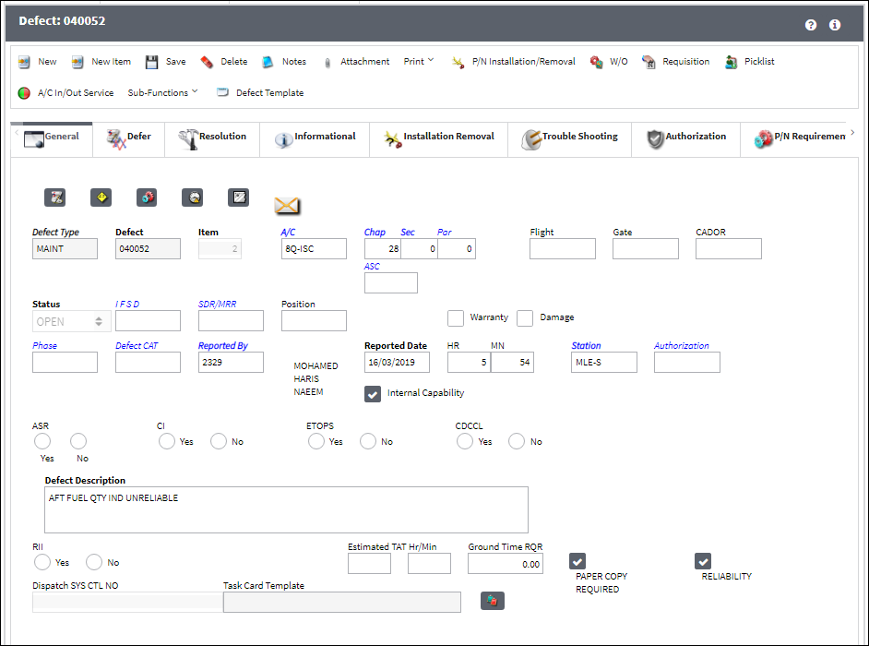
Unscheduled Maintenance
Any unscheduled maintenance event will be captured as a Defect Report in eMRO
This includes Pilot Reports, Maintenance Reports, and any other unscheduled occurrence
Defects can be turned into non-routine tasks or deferred (e.g., as MELs)

Slide 7
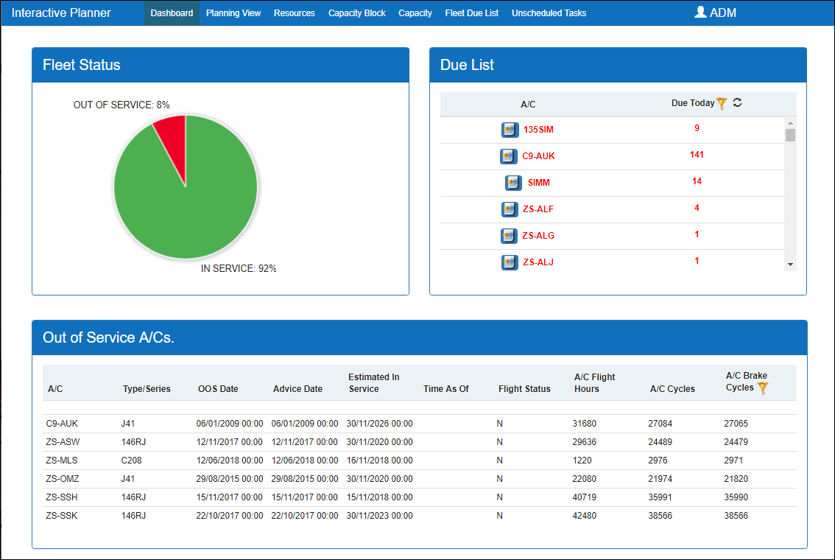
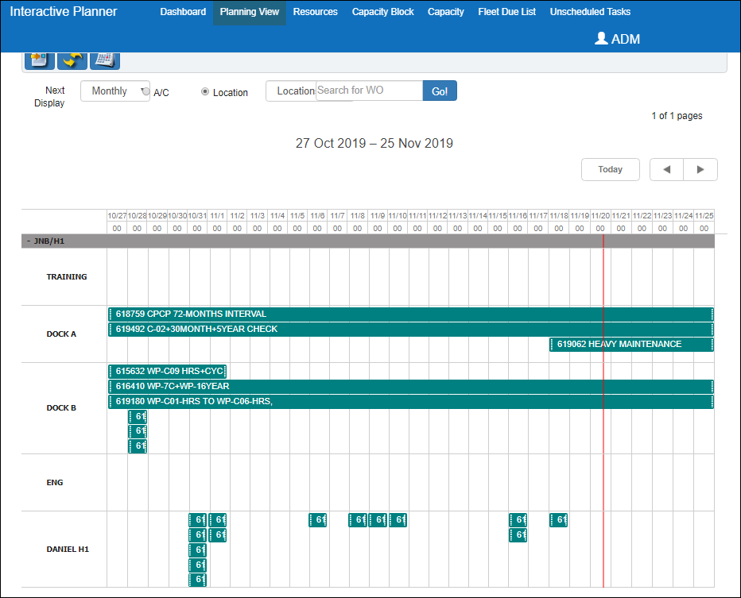
Planning
All scheduled items and deferred unscheduled items will be displayed in the Planning Query
Several views are available to schedule work efficiently
eMRO is capable of running simulations to ensure material, tools, skills, hangar space, and ground time are available for each work package
Long Term Planning allows for spacing out of larger MX events to ensure a high fleet availability

Slide 8
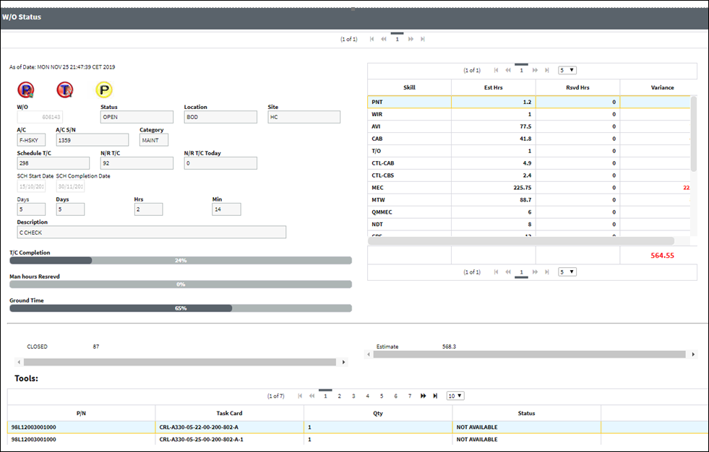
Production
In the production module, work packages can be created and managed
eMRO monitors W/O completion and cost at every step of the way
Material and Tool reservation can be done from the WO level
Manhour tracking allows for an exact breakdown of cost of maintenance by aircraft, fleet or many other criteria

Slide 9
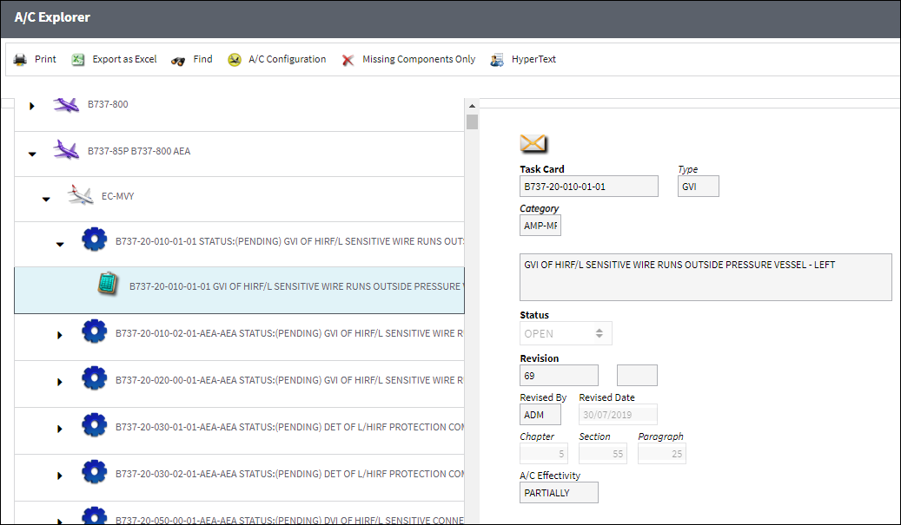
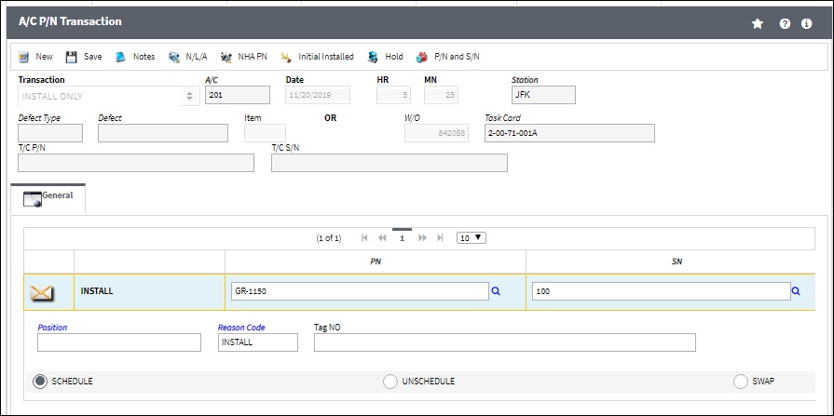
Technical Records
This module provides all requirements for controlling and maintaining technical information about your aircraft and fleet
Position Templates can be set up to control only allowed components to be installed on an aircraft
Installation and Removal data is entered in Technical Records

Slide 10
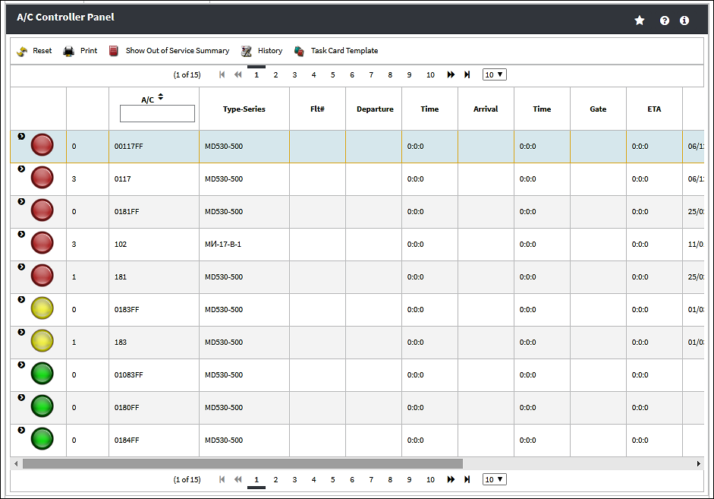
Technical Records
The Aircraft Controller Panel allows for a quick overview and management of your fleet
A/C can be taken out of and put back into service with the click of a button
All tools and information for efficient and pro-active maintenance watch are readily available

Slide 11
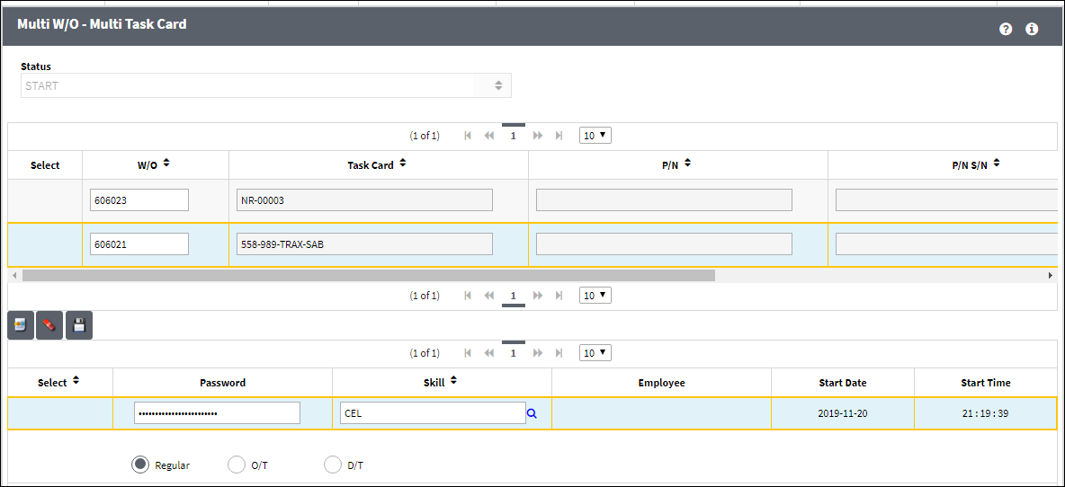
Shop
The Shop module allows to organize and track internal repairs
All work is monitored via Shop Work Orders. Full cost and status information is available at the click of a button
Shop Work Orders can be generated for Third Party Work

Slide 12
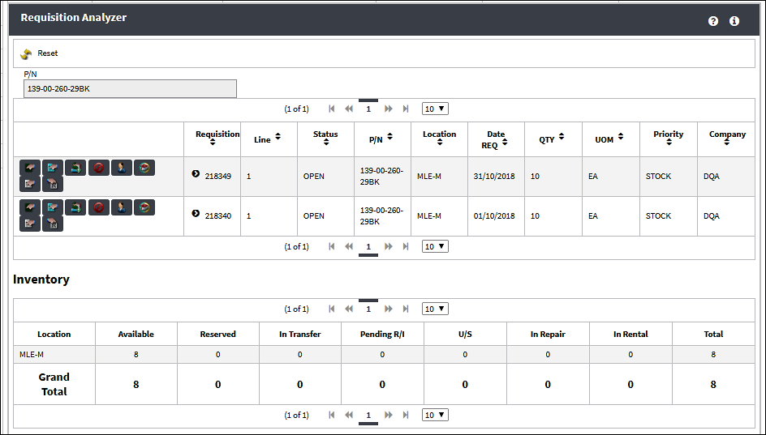
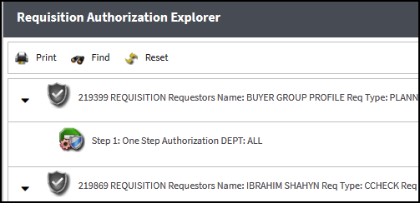
Requisitions
Material Requisitions can be triggered from many places within the application, for planning purposes, restocking, or job-specific requests
Multiple tools are available to secure an efficient handling of requisition and consolidate related requests
Auto-generated requisitions assist in keeping adequate stock levels at all time to support every day requirements
A full authorization cycle can be set up

Slide 13
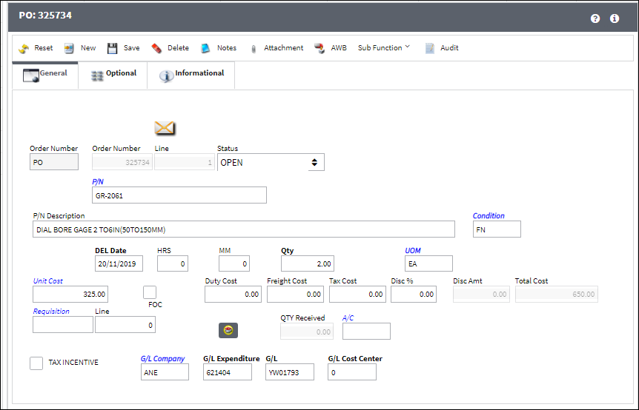
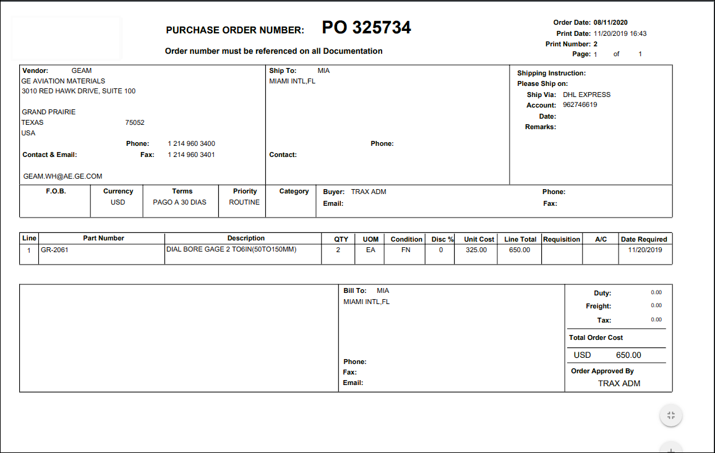
Order Management
eMRO offers a variety of different order types, such as Purchase Orders, Exchange In/Out Orders, Service Orders, Repair Orders, Customer Orders, Rental Orders, Manufacture Orders, Warranty Tracking, Insurance Claims, and Transfer Orders
Authorization settings allow users to have financial level of authorization of different order types
Vendor Management and Price Listing is available for informed order creation

Slide 14
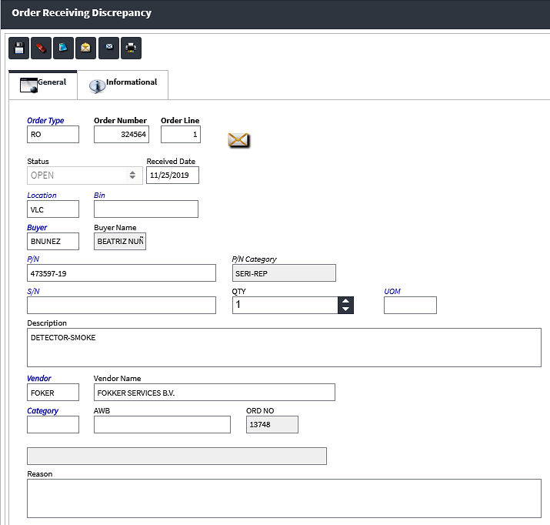
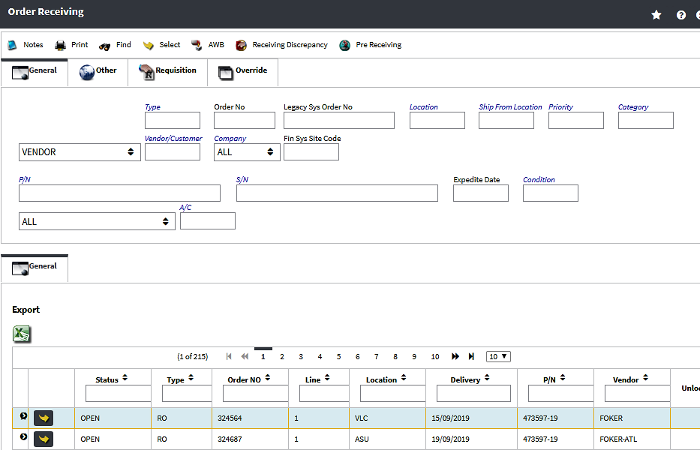
Order Receiving
The Order Receiving module allows for receiving of all order types, as well as Receiving Inspection if required
Price change and location change are available options
A full discrepancy workflow is in place to capture inconsistencies
Order details are auto-populated and verified at Order Receiving

Slide 15
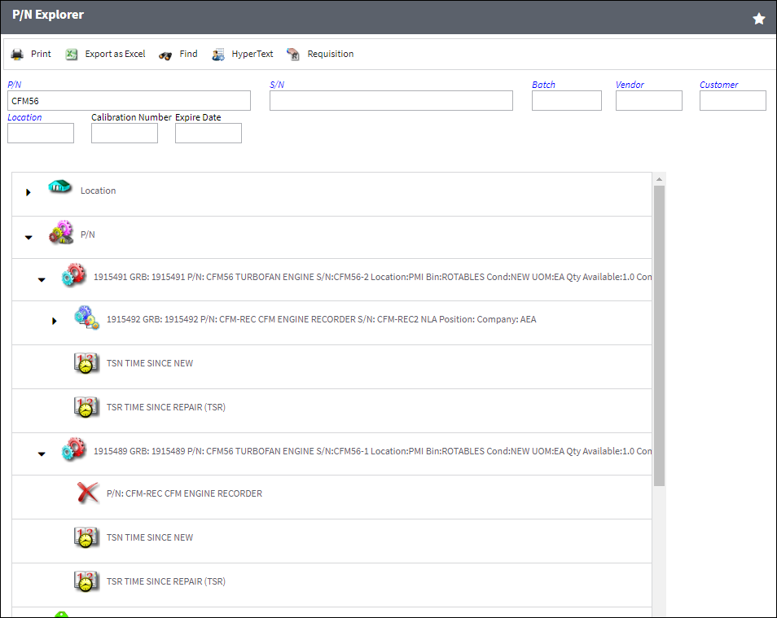
Inventory Management
The Inventory module allows for complete control and management of aircraft and non-aircraft materials, serialized, non-serialized, and kits
Standard transactions are available such as bin transfers, scrap, manual issues, part reservations, kit management, warehouse transfers, etc.
A full ‘from birth’ history is kept for each part/batch recording every part movement

Slide 16
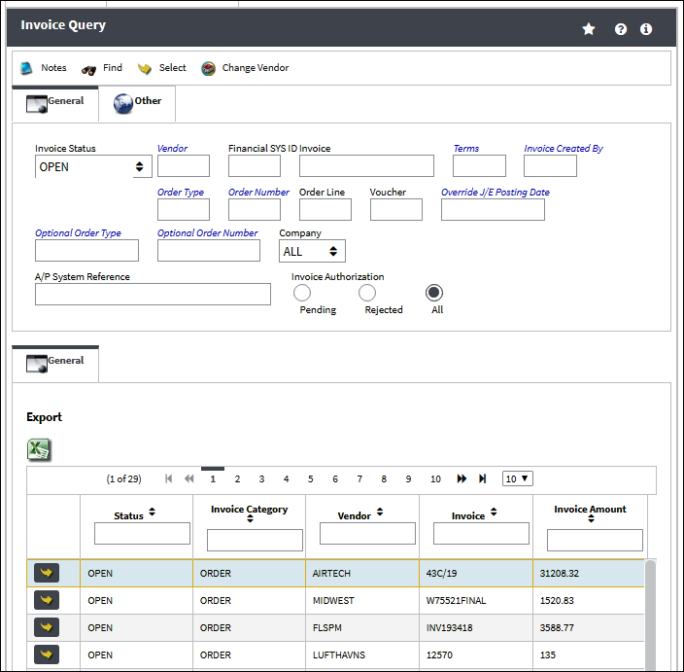
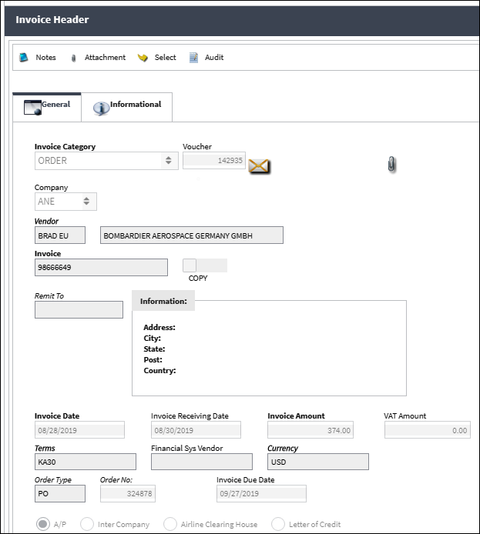
Invoicing / Link
The Link module pulls together order, receiving, and invoicing information and allows for swift order creation and three-point check
This module integrates with financial software packages to send/receive financial data in real time
Full reporting and querying functionalities are available and can be exported out of eMRO

Slide 17
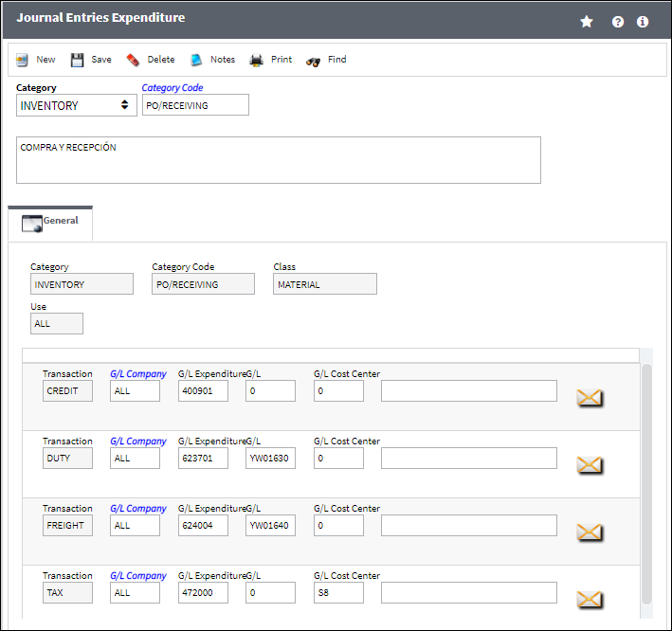
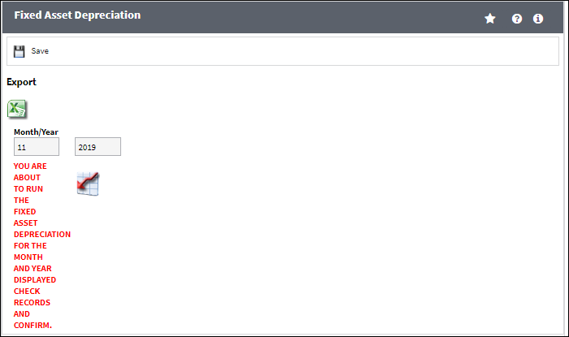
Fixed Assets / General Ledger
The Fixed Assets module creates and individual record for each asset controlled by the system
Multi Company functionality is available to enable separate tracking for different companies within the same database
The General Ledger interface sends on-line journal entries to your company’s financial systems

Slide 18
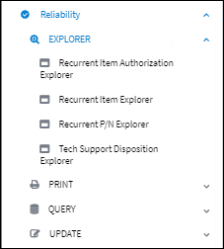
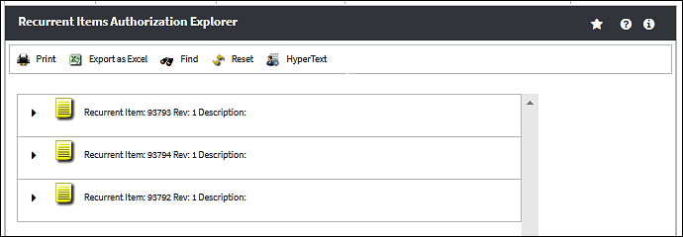
Reliability
Management and Aviation Authority requirements can be met by collecting data information directly from the eMRO system without the need of additional software
Aircraft and Component reliability can be monitored and automated notification generated when alert levels are surpassed
Various Reliability Reports are available

Slide 19
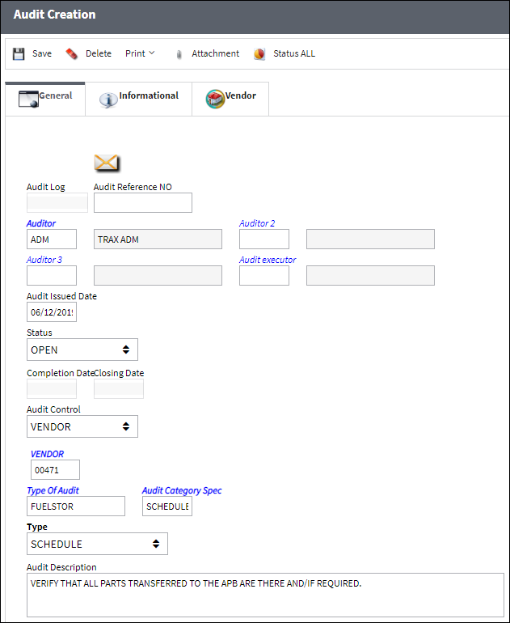
Quality Assurance
The Quality Assurance module is an effective internal and external evaluation program that will bring benefits that go beyond regulatory compliance
One-time and recurring audits can be managed to assure approved vendors and to improve efficiency

Slide 20
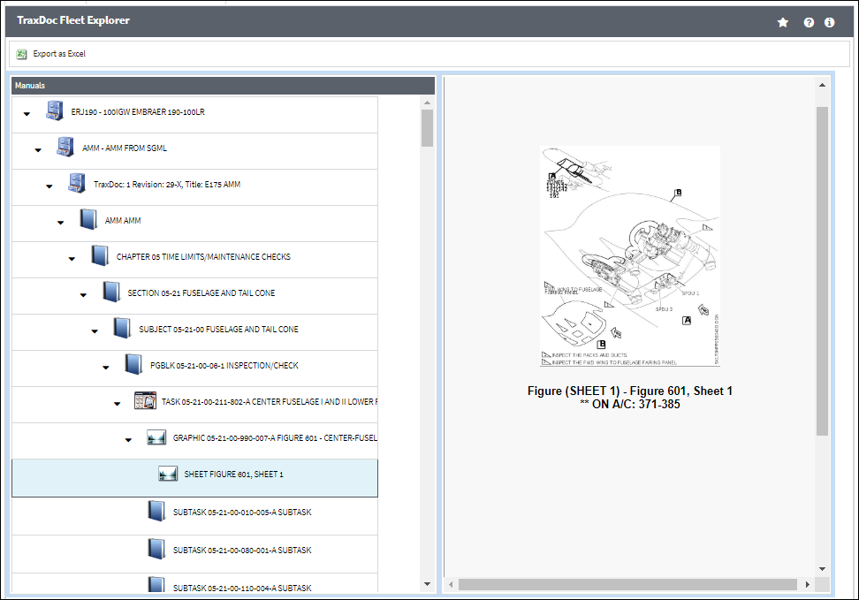
TraxDoc
The TraxDoc module is a full documentation management system internal to the eMRO application
Documents of any format can
be uploaded, stored and revision controlled
OEM data can be loaded electronically in SGML or XML format
Data can be created directly from TraxDoc (e.g., Task Cards, Part Number Master records,
Engineering Controls, etc.)

Slide 21
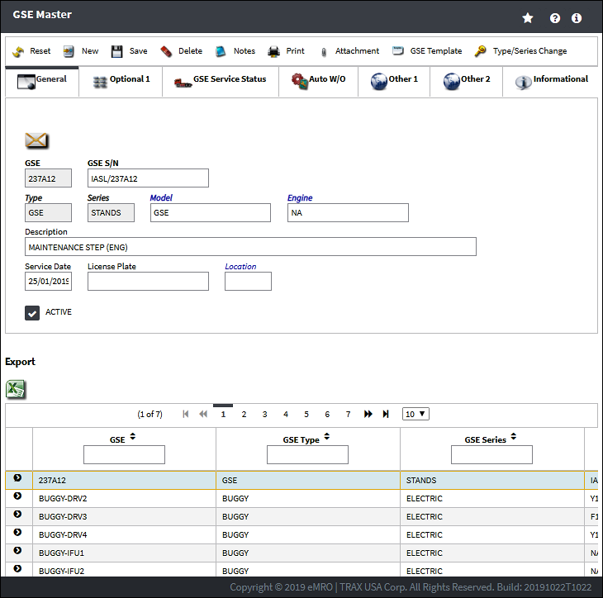
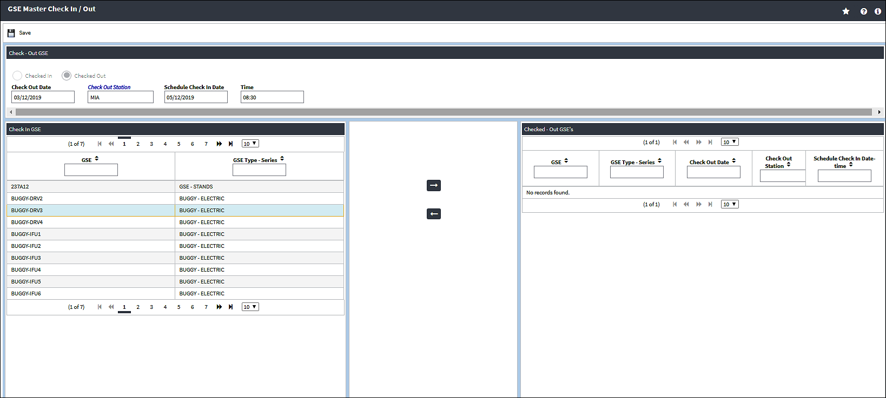
Ground Service Equipment
The GSE module allows for planning, maintenance, and monitoring of all GSE related equipment
Multiple GSE types can be tracked
A separate purchasing and inventory management system are available to segregate the different part pools and enhance user security
The GSE module has the same functionalities as various eMRO modules as they apply to Ground Service Equipment

Slide 22
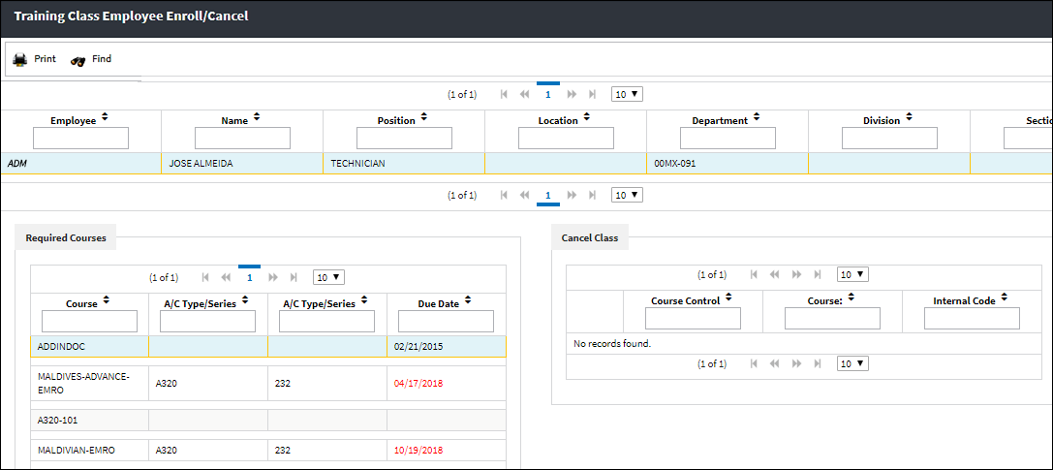
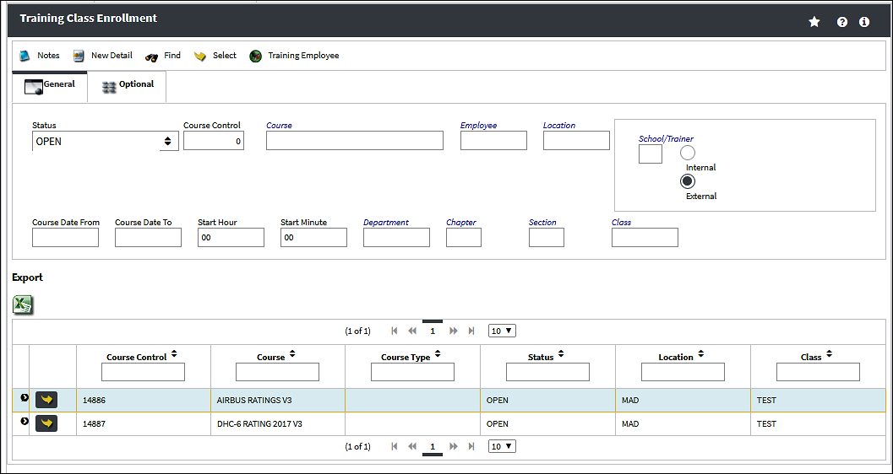
Training / Skill Management
eMRO can maintain and monitor a full training program for internal and external employees
Skills are automatically flagged for renewal and employees notified of expiring skills
eMRO automatically verifies if a user is authorized to perform a certain transaction based on the skill level

Slide 23

Pilot Inspections
Resource & Maintenance Planning
Cabin Crew Inspections
Task Management
there’s an app for every task
Diagram and Reference Manuals
Turn flights
Stores
Visual Check

Slide 24

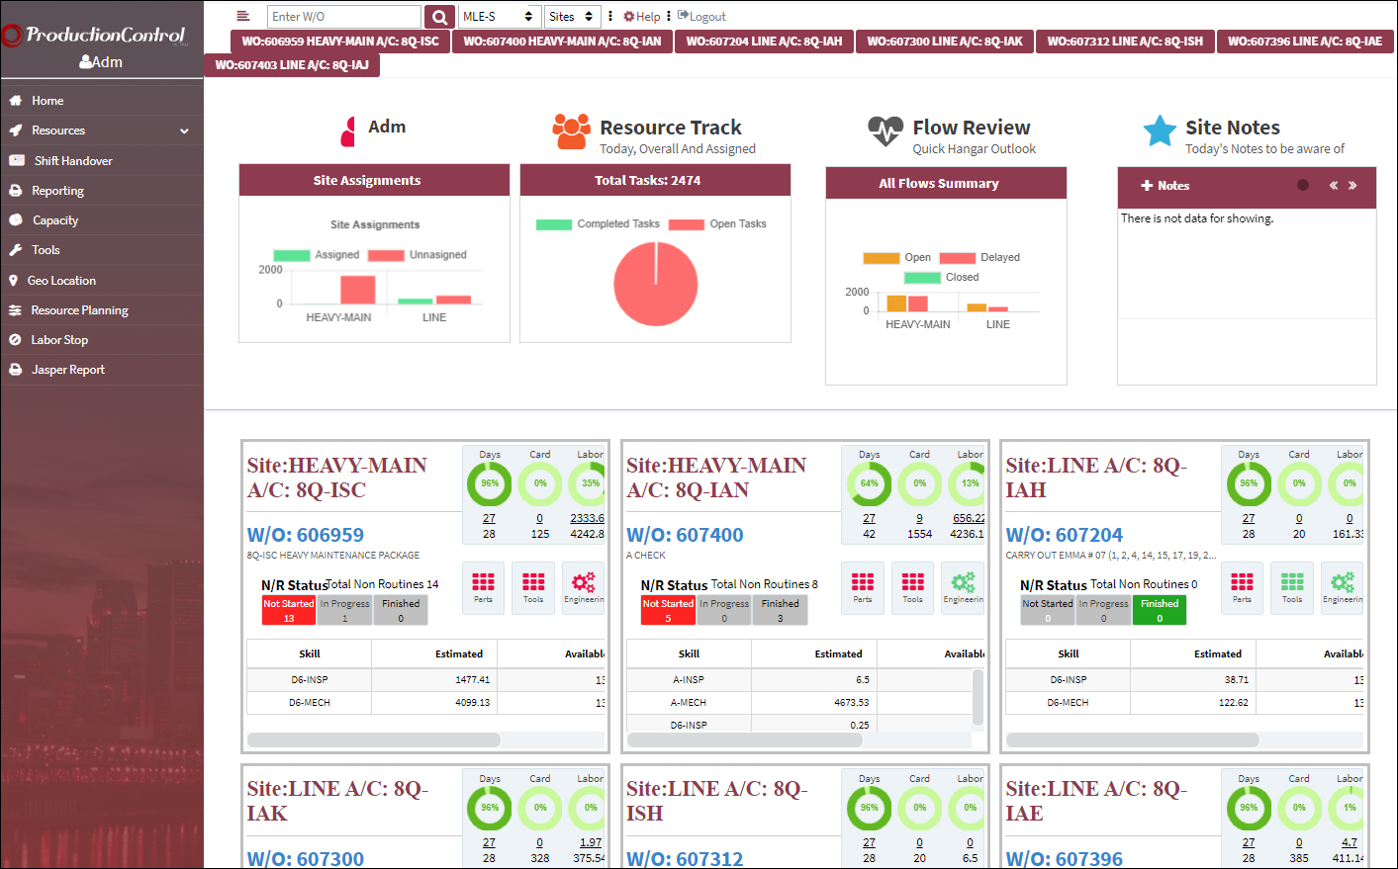
Production Management Solution
Dashboard adapts to unique maintenance worksites
Color-coded indicators for quick and easy overviews
Accommodates:
Work Orders, Task Cards, Man Power Assignments, and Work Turnovers
Helps production controllers keep tabs of all tasks, deadlines, and non-routines
Web-based app can be utilized from tablets or PCs

Slide 25

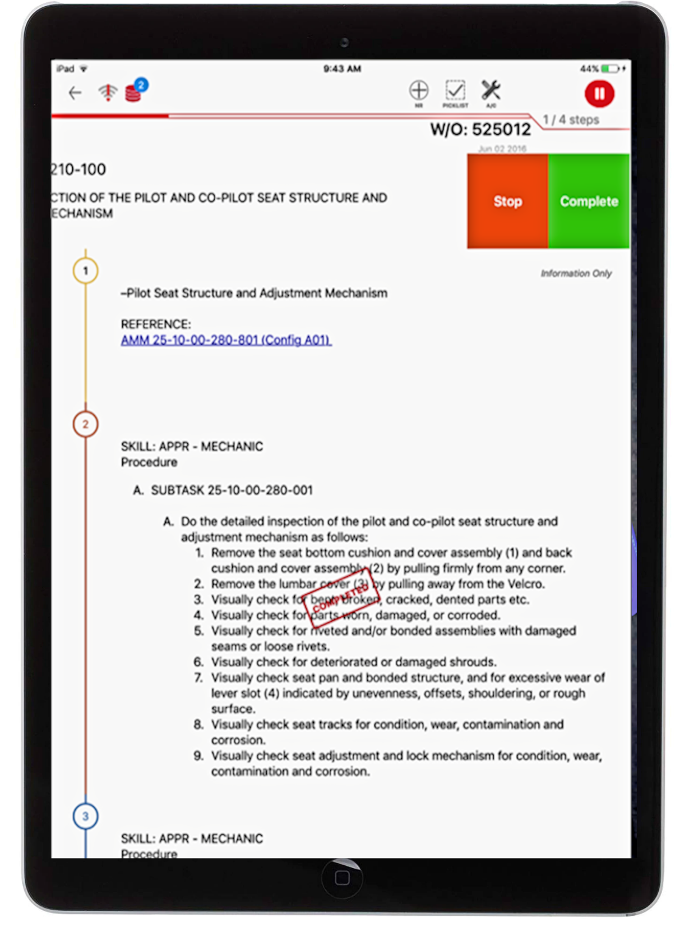
TaskControl
Electronic Task Cards
Mechanics and inspectors can review their assignments
Users can:
Start, Stop, Defer, and Complete tasks
Create Non-Routine Tasks
Install / Remove parts
Review / Create Picklists
Complete Surveys
Complete Work Orders
Reference manuals linked seamlessly to AeroDox
Users can work online or offline
Can log in with Password, Pin, or Touch ID
Read & Sign feature is availableC

Slide 26

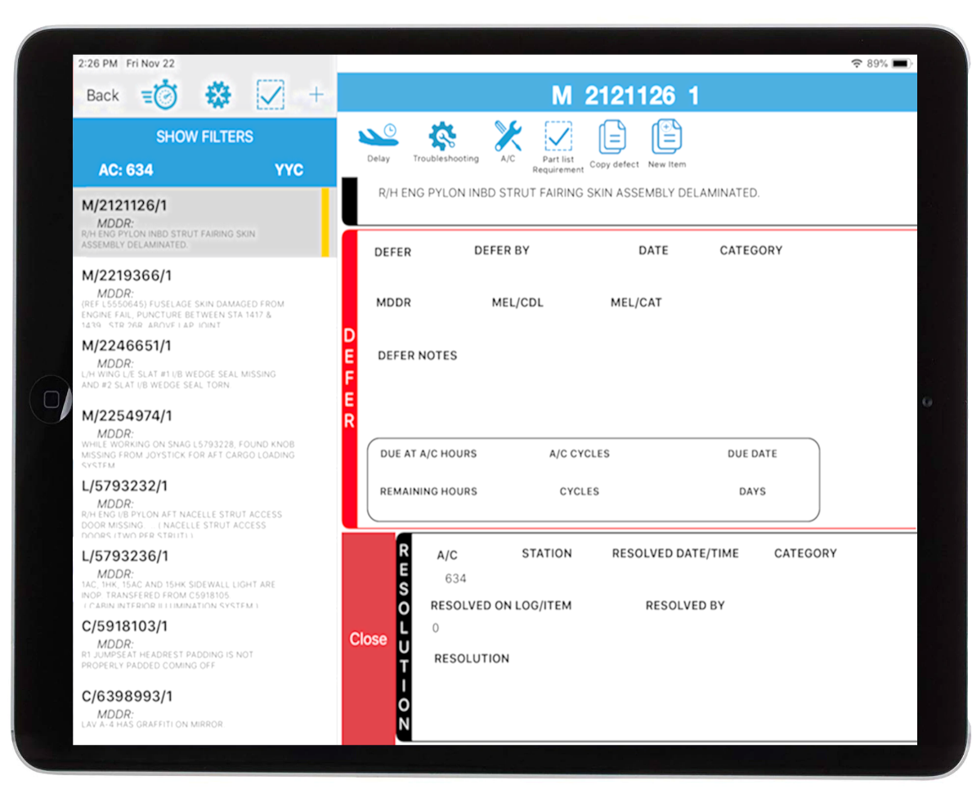
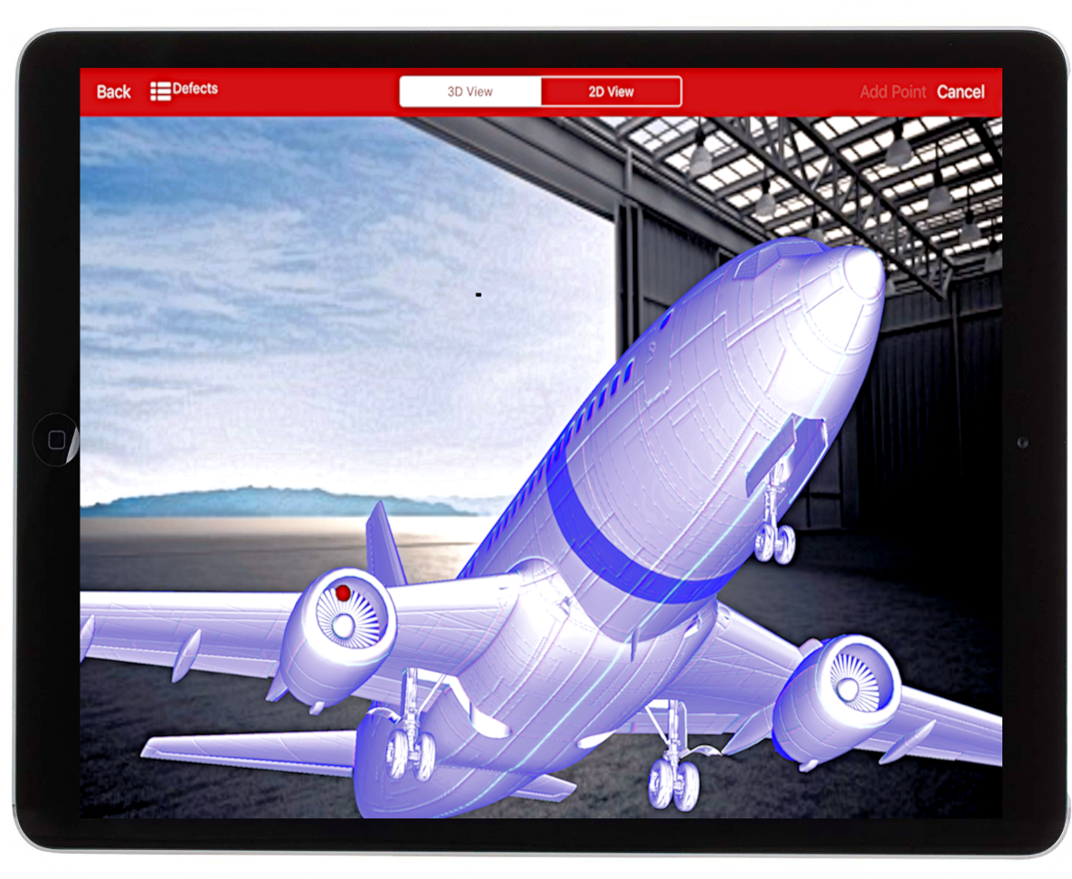
QuickTurn
Gate Maintenance Activity Tool
Resolve or defer defects at the gate
Prep for incoming flights
Interactive Dent Mapping
Users can:
Add Troubleshooting Steps
Record Delays
Install / Remove parts
Review / update Picklists
Work can be conducted offline
Can log in with Password, Pin, or Touch ID
Read & Sign feature is available

Slide 27

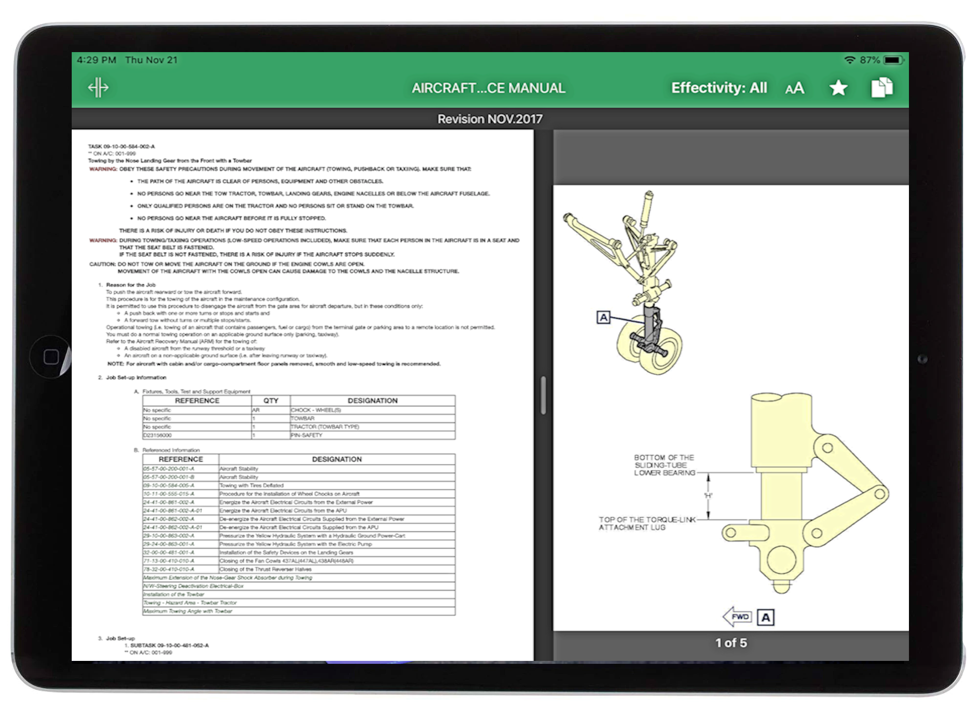
AeroDox
Digital Documents
View maintenance manuals
Accesses TraxDoc manuals
Connects seamlessly with other Trax iOS apps
Manuals can be downloaded to tablet for offline access
Can log in with Password, Pin, or Touch ID
Read & Sign feature is available

Slide 28

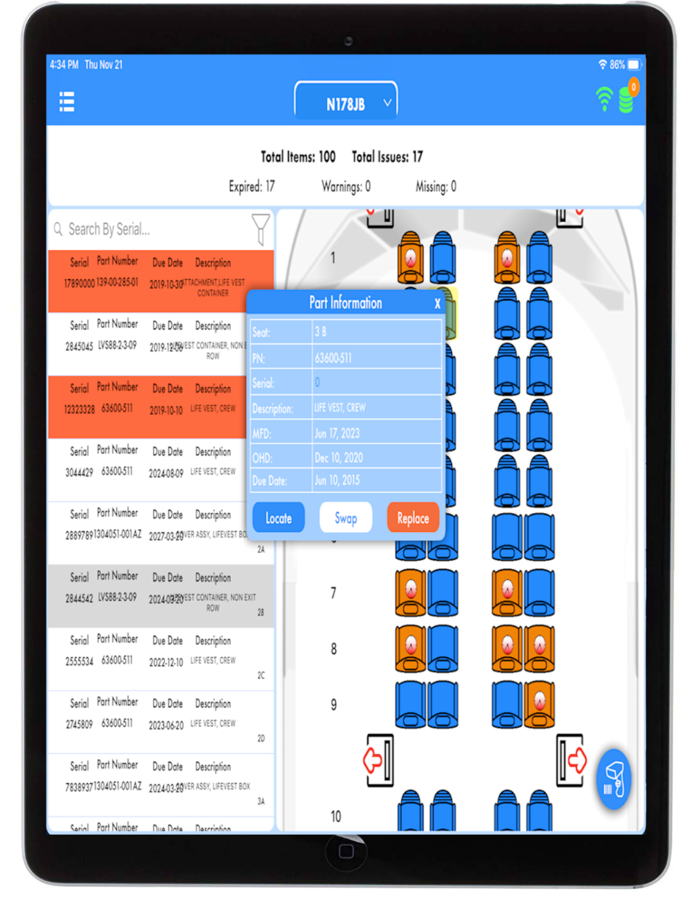
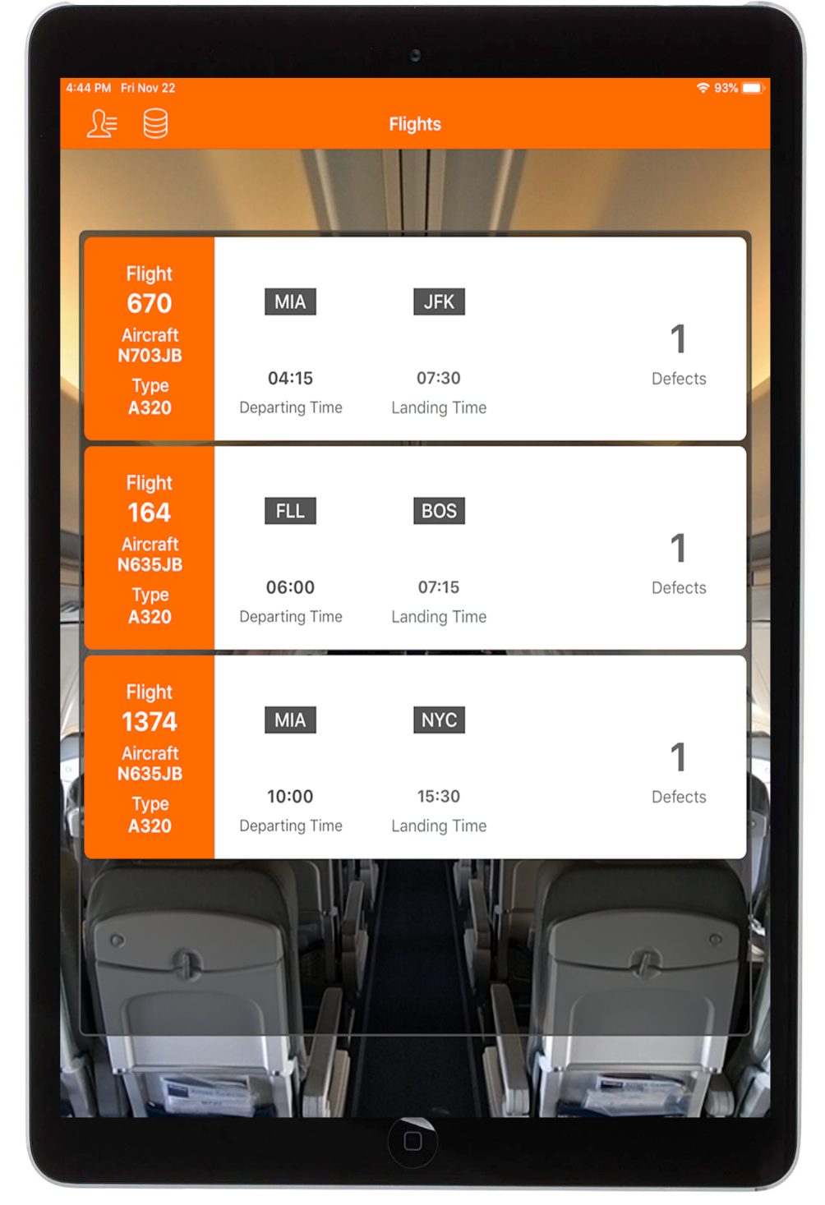
CabinLog
Cabin Crew App
Monitor cabin before, during, and after flight
Record Defects
Interactive seating map
Sync with database when in range
Can log in with Password, Pin, or Touch ID
Read & Sign feature is available

Slide 29

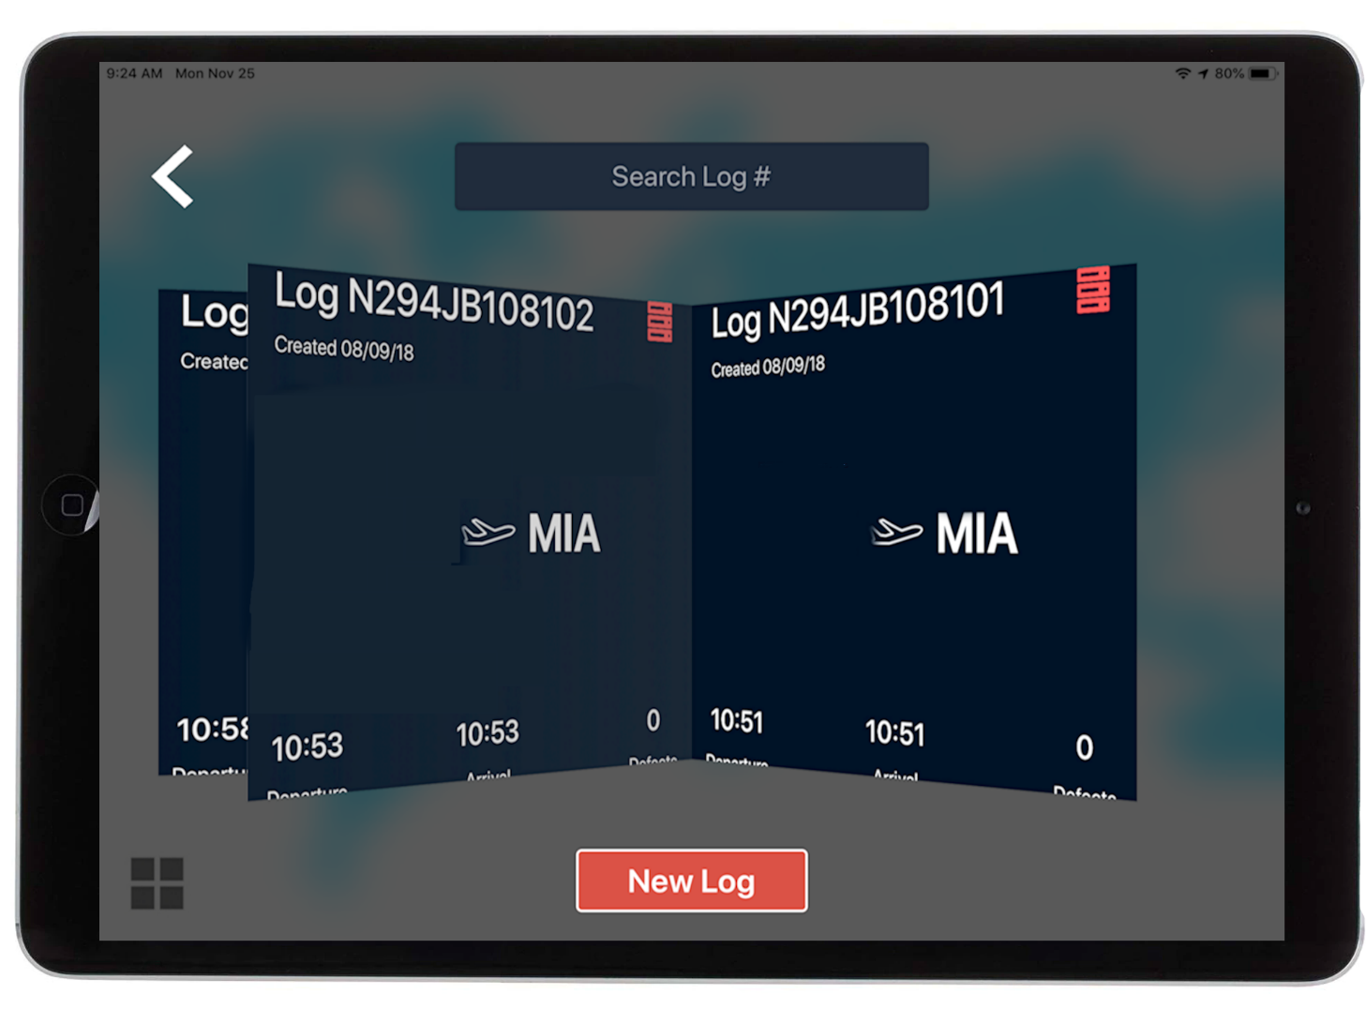
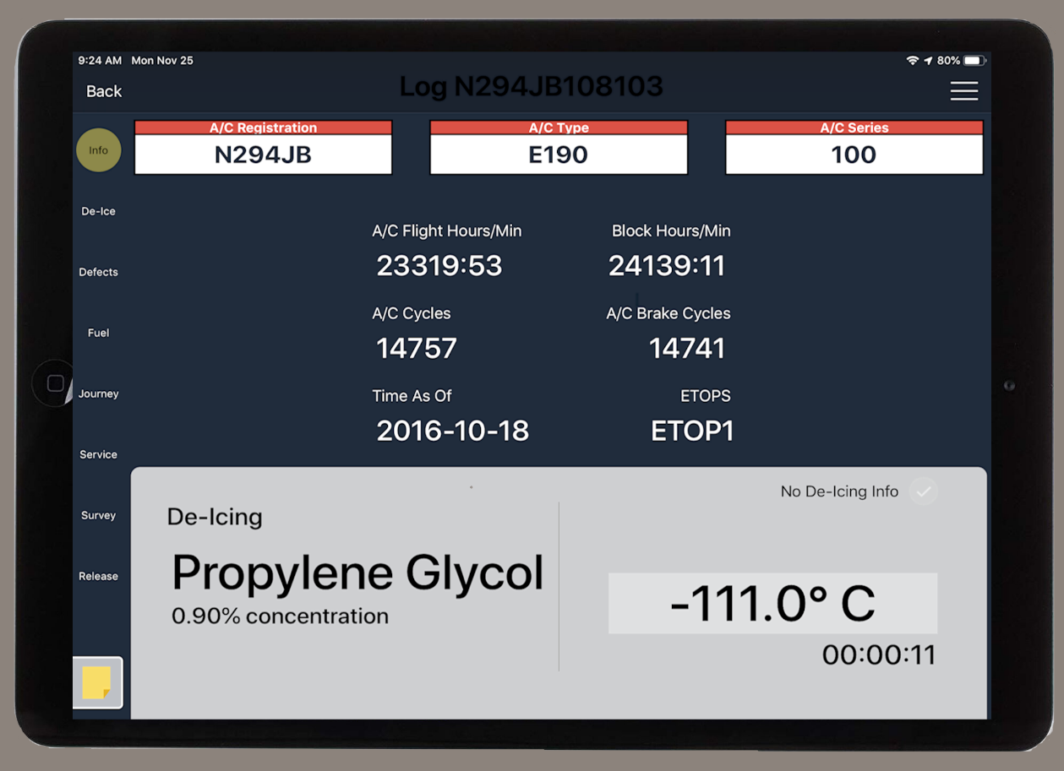
PilotLog
Pilot App
Monitor aircraft before, during and after flight
Record:
Fuel levels
De-icing
Aircraft Units
New Defects
Sync with database when in range
Can log in with Password, Pin, or Touch ID
Read & Sign feature is available

Slide 30

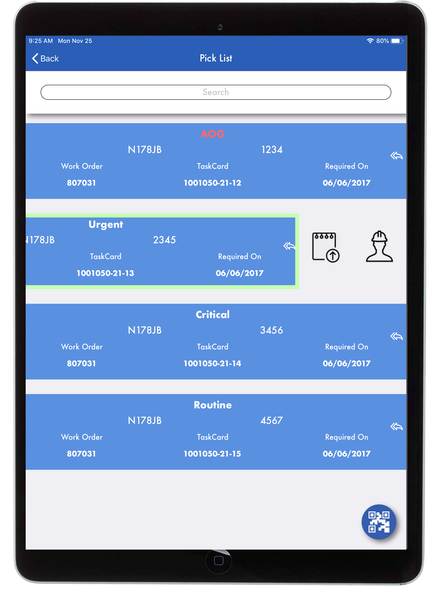
EzStock
Inventory Transaction Tool
Perform common inventory transactions via iOS tablets and radio frequency scanners
Single scan barcode / multi RFID-based transactions:
Picklist Issuing
Packing & Shipping
Return to Stock
Order Receiving
Bin Transfer
Inventory Query
Physical Count
Inventory Adjustments
Tool Check In / Out

Slide 31

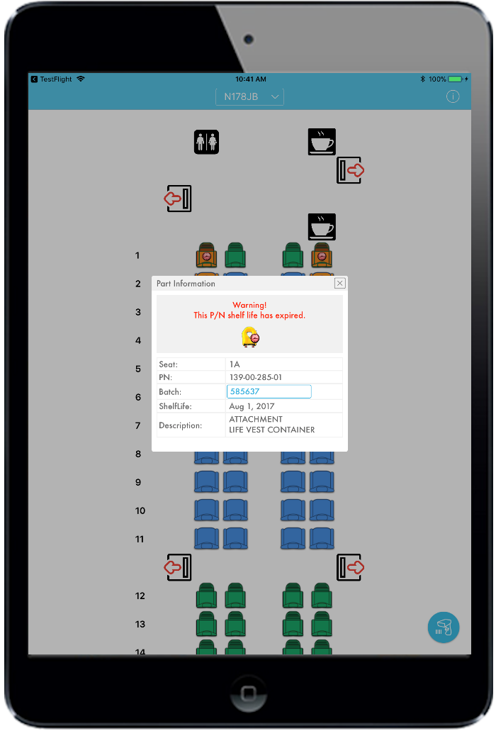
visualCheck
Emergency Equipment Inspections
Solution for missing/expired emergency items
Uses RFID to speed up maintenance of emergency equipment
RFID tag data:
P/Ns, expiration dates, physical locations
Tag items can be:
oxygen bottles, life vests, smoke masks, medical kits, flashlights, safety placards, etc.

